Slide 1
Functional Annotation
Metagenomics Lecture 3

Slide 2
Functional Annotation
Primary advantage of using metagenomics data over 16S
“What are the microbes doing” vs “What microbes are here”
Goal is to examine how your collection of genes or other functional units differ across samples

Slide 3
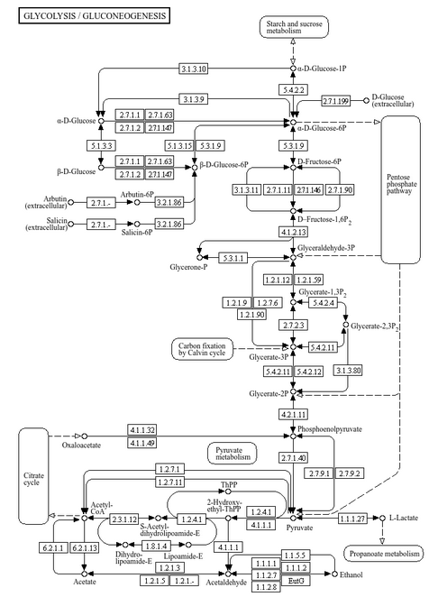
What is meant by function?
The scope can vary depending on your approach
Wide variety of options
General function
Metabolic pathways
Glycolysis
Amino acid metabolism
Cellular responses
Immune system evasion
Gene-level
Antimicrobial resistance gene
Specific gene/ enzyme of interest

Slide 4
Challenges in Functional Annotation
Similar challenges to taxonomic annotation
Partial gene fragments provide little info
The same gene may not look the same in different taxa
Resource intensive due to size of databases and samples
Biases from unequal sequencing depth, gene length
Can be problematic to group by function across diverse taxa
Notes:
Similar to challenges with taxonomic annotation

Slide 5
Components of functional annotation
Similarity search tool
DNA-based tools: BWA, Bowtie2
Fast, but only recognizes highly similar sequences
Protein alignment tools: blastx, DIAMOND, mmseqs2
Slower, but more sensitive
Database
Larger databases are more comprehensive and provide more coverage
Ex. RefSeq, UniProt, Ensembl
Smaller databases can provide specialized areas of function
Ex. CARD, CAZymes, HMMs
Notes:
Slow is relative, diamond can still be very fast
Databases:
We’ll get into HMMs later

Slide 6



Database challenges
It is likely that you will need multiple sets of annotations
Many databases/ database tools built for human data are not built for microbiome work
Ex. Ensembl Bacteria, KEGG
Keeping track of annotations can be difficult
Notes:
Ex. We are going to be using both uniport and CARD for the lab
For example, ensembl is very comprehensive for humans, and there is ensembl bacteria, but the popular tools do not tend to support its usage
Speaking from experience, keeping multiple annotations organized is a hassle, so you’re going to want to be very organized

Slide 7
Various General Function Databases
UniRef (Uniprot)
Several different options based on resolution and clustering identity
Uniparc, Unref50, Uniref90, Uniref100
KEGG
Organizes annotations into pathways and modules
PFAM
Protein domains
SEED
Used by RAST and MG-RAST
COG
Popular but has not been updated since 2003
Notes:
Rast and mgrast are tools for bacterial genome annotation and mgx annotation

Slide 8
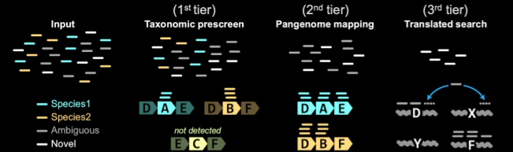
Metagenomics Annotation
How do we apply this to metagenomics?
Web-based tools
MG-RAST
RGI online
Local tools
MEGAN6
HUMAnN3
Notes:
Web based tools are more limited – either by size, time, or customizability
MEGAN6 is a very old tool that is simple and easier to use – the similarity search is done over a server but it’s all put together by megan – definitely a good option if you really want to avoid bioinformatics

Slide 9
Downstream Analyses
Differential gene abundance
ANCOM-BC
DESeq2
ALDEx2
Gene set enrichment/ overrepresentation analysis
Clusterprofiler
fgsea
Hypergeometric test/ Fisher’s Exact test

